Slide 1

CSS Selectors
M3-02
Participate! The more engagement the better! You are NEVER interrupting me!

Slide 2
Objectives
HTML Element Hierarchy
CSS Selectors
Box Model
Displays (Inline, Block, Inline-Block)
Positioning

Slide 3
HTML Element Hierarchy
Each HTML element has a hierarchical relationship with other elements.
All elements, except the root element (<html>) has a single parent element
A Parent is the element that the current element is included in.
Elements can have 0...n child elements
Children are elements included in the current element.
Elements can have 0...n sibling elements
Sibling elements are elements with the same parent

Slide 4
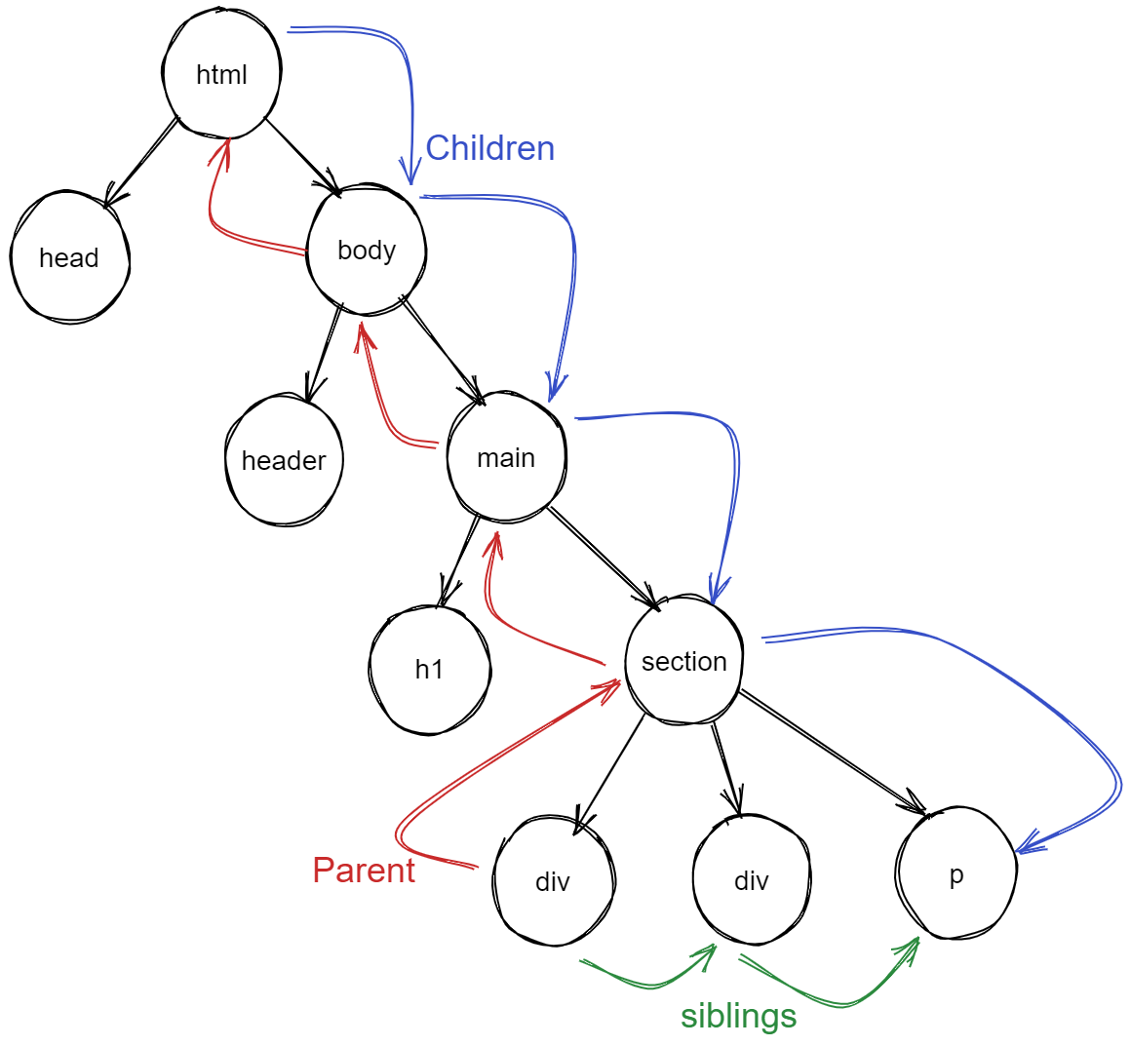
<html>
<head></head>
<body>
<header></header> <main> <h1></h1>
<section>
<div></div>
<div id=”box-2”><div>
<p></p>
</section>
</main>
</body>
</html>

Slide 5
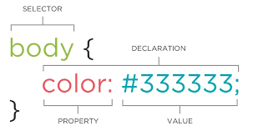
CSS Selectors Format:

Slide 6
Element Selector
Uses the element name to select and apply the CSS:
a {
color: red;
}
h1 {
font-size: 24px;
}
<a href=”someurl.com”>click here</a>
<h1>Title Here</h1>

Slide 7
Id Selector
Uses the element id to select and apply the CSS to that specific element that has a matching id.
#specialBox { color: green; }
<div id ="specialBox”>
Use id's when elements are not going to be used anywhere else. Where you need the element to be unique

Slide 8
Class Selector
The class selector is used to select all elements which belong to a particular class attribute
.redBox { color: red; }
<div class="redBox”>
Use class selectors when elements are going to be reused and you want to apply the CSS in a consistent way.

Slide 9
Group Multiple CSS Selectors
You can group multiple selectors together, using a comma. Common essentially means “and”
div, p { color: green; } .red { color: red;}
This selector applies to all div and paragraph elements.
p.red, #sub { color: green; }
This selector applies to all paragraphs that have a class attribute of red and any element with an id of sub

Slide 10
Decendant Combinator
We can combine CSS Selectors using a decendant selector (space between two selectors)
.box-1 h2 { bg-color: green; }
<div class="box-1”> <h2>My Title</h2> <div> <h2>AnotherTitle</h2> </div>
</div>

Slide 11
Child Selector
Gets all li elements inside the ul
ul > li { … some declarations...
}
<ul> <li>Item 1</li>
<li>Item 2</li>
<li>Item 3</li>
</ul>

Slide 12
Adjacient Sibling Selector
The adjacent sibling combinator (+) separates two selectors and matches on the second element only if it immediately follows the first element, and both are children of the same parent element.
<div>
<img src=”...”> <p>My paragraph</p>
<p>My paragraph</p> </div>
img + p { … some declarations...
}

Slide 13
General Sibling Selector
The general sibling combinator (~) separates two selectors and matches the second element(s) only if it follows the first element (though not necessarily immediately), and both are children of the same parent element.
<div>
<img src=”...”> <h2>title2</h2> <p>My paragraph</p>
<p>My paragraph</p> </div>
img ~ p { … some declarations...
}

Slide 14
CSS Selectors
https://www.freecodecamp.org/news/css-selectors-cheat-sheet/
Universal Selector: *
Element Selector: div
Id Selector: #divThree
Class Selector: .spanOne
.Descendent Combinator: .special h2
Child Selector: #divThree > span
Adjacent Sibling Selector: .spanOne + span
General Sibling Selector: .spanTwo ~ span
Pseudo-class Selector: div :first-child div :last-child div :nth-child(2) div:hover
List of Pseudo-classes

Slide 15
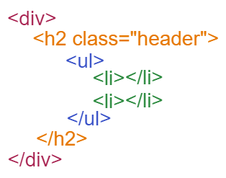
CSS Selectors
CSS Selectors can be combined to achieve greater specificity
div h2 .header ul > li {
background-color: red;
}
This selector will select all li elements that are a child of an ul that is a descendent of an h2 element that has the header class applied to it, that is is a descendent of a div

Slide 16
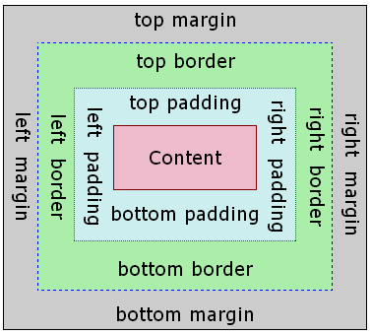
Box Model
All elements are represented on the page as a box with 4 parts.
content
padding - space between the content and the border
border - border around the box
margin - space outside the border before another box can start
width: 100% is not 100% the size of the content. It is 100% of the space allowed inside the container box the element box is within.

Slide 17
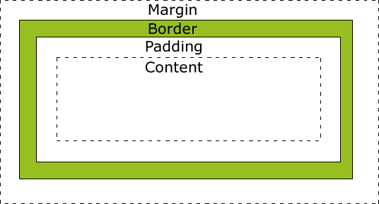
Box Sizing
border-box
box-sizing: content-box|border-box
content-box - default, width/height include only the content.
border-box - the width/height includes content, padding, and border.
Box Sizing on W3Schools
content-box

Slide 18
Display
block
Starts on a newline
Takes up full available width
can set width/ height
default for: div, h1, p, form, header, footer, section, etc.
inline
Starts on same line
Takes up only width required for content
Cannot set width/height
default for: span, img, a, etc.
inline-block
Like inline
Can set width/height
content
content
a
content
a
a

Slide 19
Positioning
Static
Relative
Absolute
Fixed
Notes:
The normal flow of a page is for elements to appear left to right and top to bottom based on the order in which they appear in the HTML document and the rules of block and inline display.
Static position by default means the element conforms to normal flow.
Relative position means relative to where it would otherwise be positioned in the normal flow.
You can set the top, right, bottom, and left positioning attributes.
Absolute position places the element relative to the parent ancestor—that is, the containing element—exactly where you specify.
These elements are removed from the flow of the page.
Setting both top and bottom, or both left and right allows you to "stretch" an element's dimensions.
Fixed position is relative to the browser window and does not scroll with the page.
You can set the top, right, bottom, and left positioning attributes.

Slide 20
Units of Measurement
Full list of Units of Measurement
Absolute Units - fixed size
px | pixels | 1px = 1/96 of 1 inch. However, pixels are relative to the device, as 1px is 1 dot on the viewing device. Viewing devices have different pixel sizes.
Absolute Units of measurement should be avoided, and do not scale with different devices. Though they are sometimes still needed.
Relative Units of measurement should be used when possible, as they scale with different devices.
Relative Units - size is relative to another property
em | Relative to the font-size of the element. (2em = 2xs the current font size)
rem | Relative to the font-size of the root element.
vw | Relative to 1% of the width of the viewport
vh | Relative to 1% of the height of the viewport
% | Relative to the size of the parent element

